Slide 1

The French and
Indian War

Slide 2
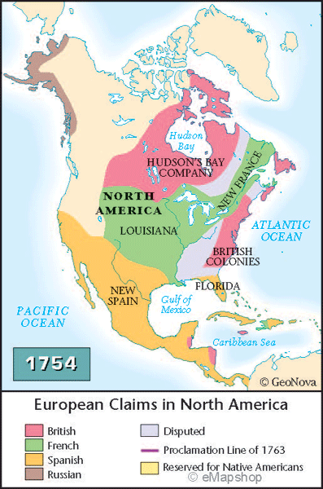
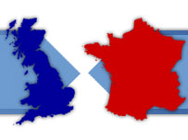
Causes of the Conflict…
Competition between
England + France
Fur trade and overlapping land claims

Slide 3

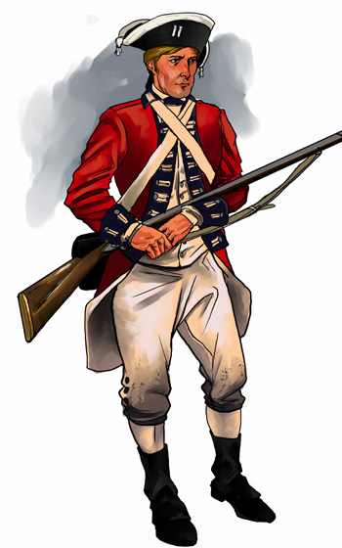
British
Advantages
1. Population: 2 million in English colonies, only 75,000 in French colonies.
2. Located along the coast, easy to move resources
3. Permanent settlers fighting on their own land

Slide 4

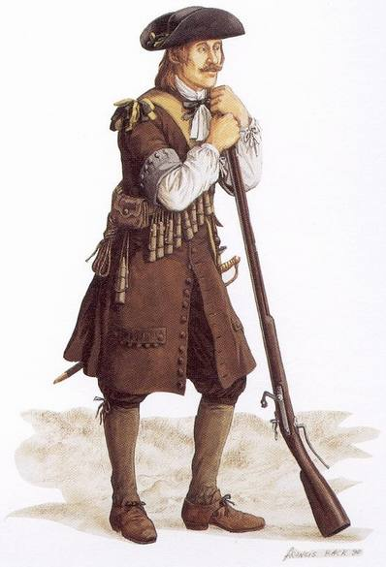
French Advantages
Controlled the interior of America
One colonial government (no separate colonies to deal with)
Help from local Indians Huron and Algonquin

Slide 5
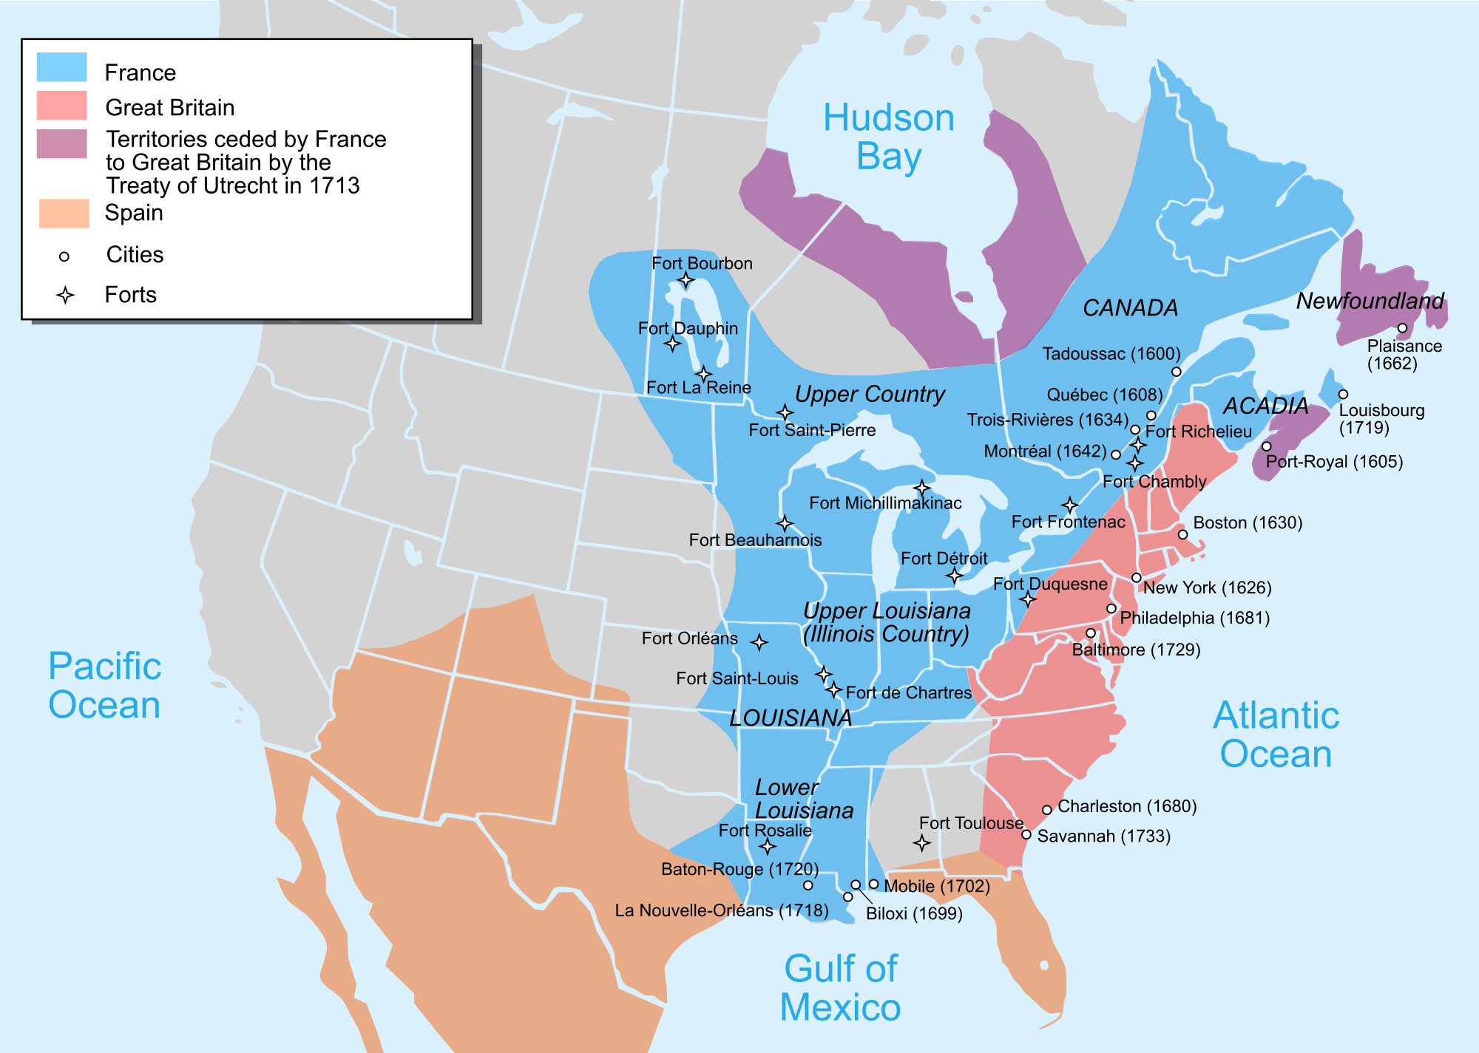

Slide 6
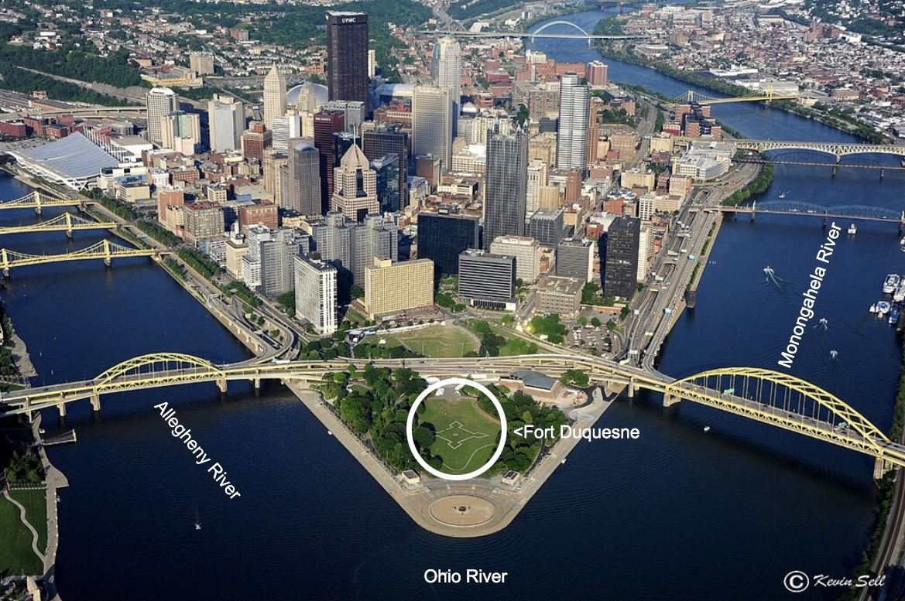
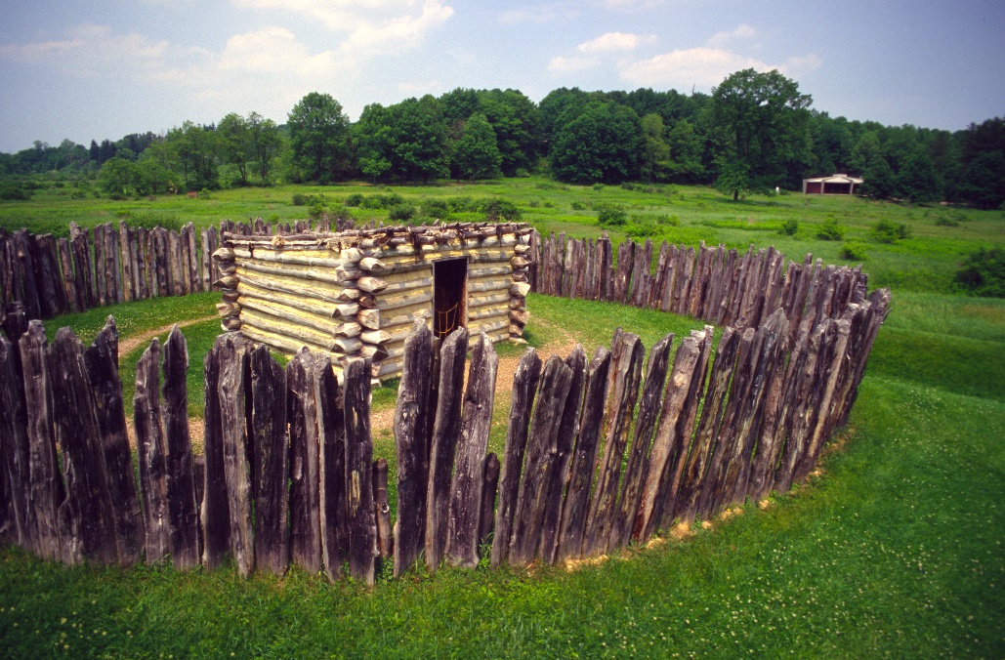
The French and Indian War
(1754-1763)
AKA: “The Seven Years War”
-starts in America!
Starts when George Washington attempts to force the French to evacuate Fort Duquesne
(modern-day Pittsburgh, PA).
He and the Virginia militia are defeated at nearby Ft. Necessity, and his forced confession starts the war.

Slide 7
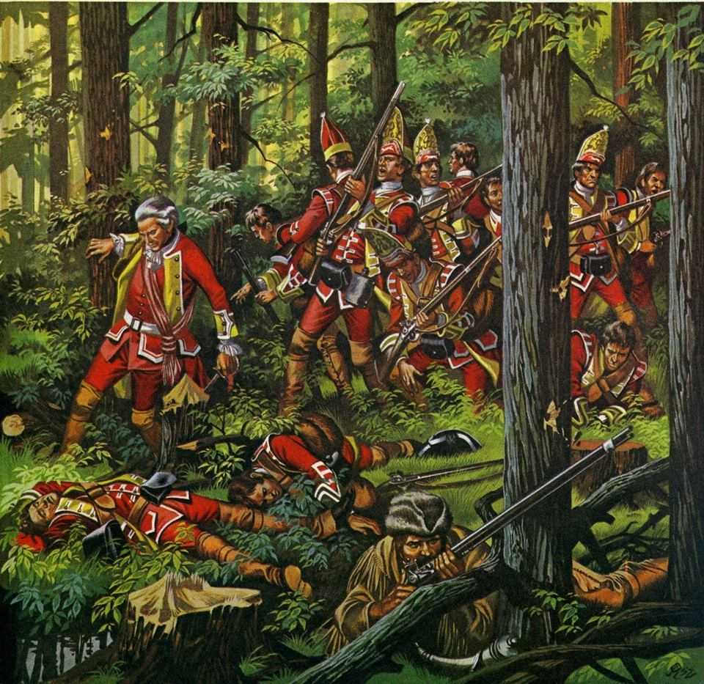
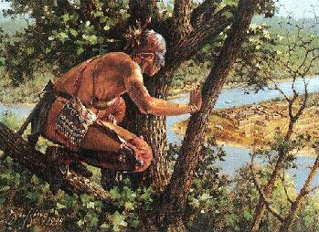
First British Offensive
British General Edward Braddock, trying to capture Fort Duquesne, is ambushed and he and half of his men are killed or wounded at the Battle of the Monongahela, near Pittsburgh PA.
38:30

Slide 8


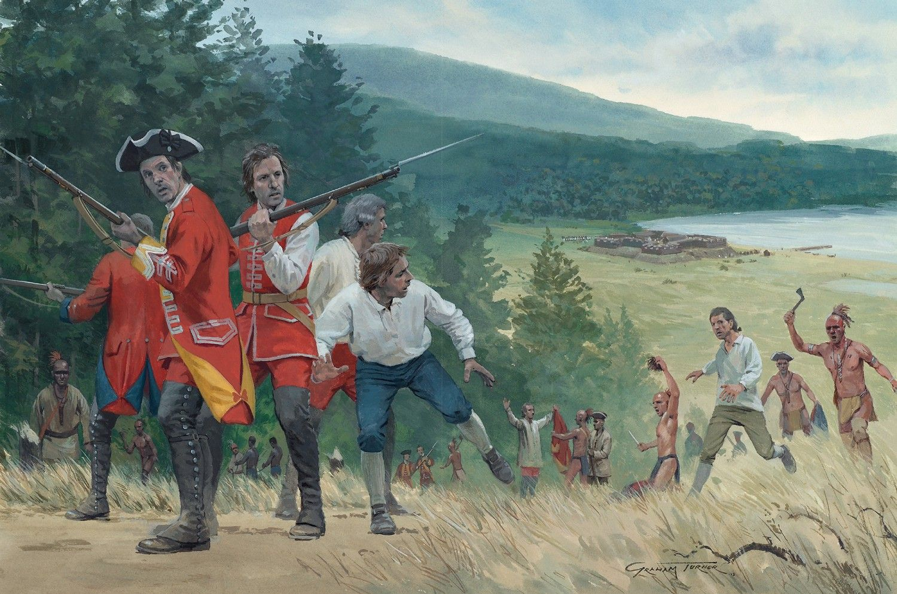
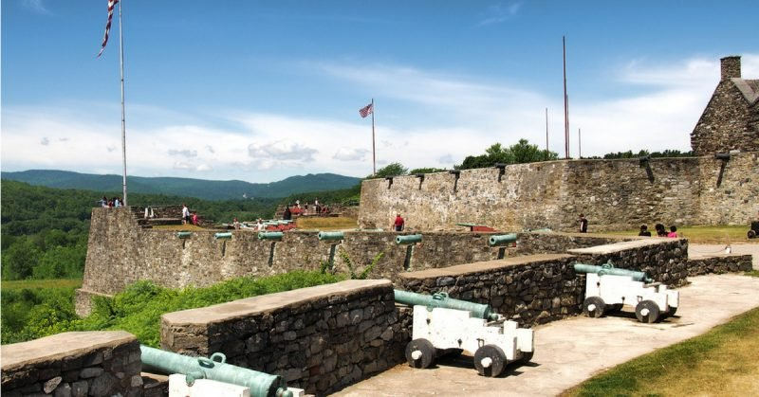
A String of Failures
Although the British capture French forts in Nova Scotia, French general Marquis de Montcalm captures Fort William Henry (before the ensuing “massacre”), and defeats a British force attacking Fort Ticonderoga (both in upstate New York)

Slide 9
Ft. beausejour
Ft. Ticonderoga
Ft. William Henry
Braddock’s Expedition

Slide 10
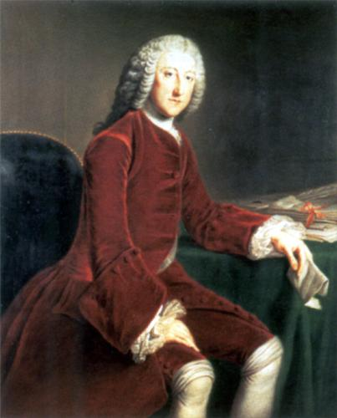
William Pitt
British de facto Prime Minister
Decides to focus on eliminating the French threat for good
Sends his best generals, more men, ships, and supplies to the war zones around the world (India, Europe, Africa, and America)
Spends LOTS of money
Promised to include colonial forces and reimburse the colonies for their war expenses.

Slide 11
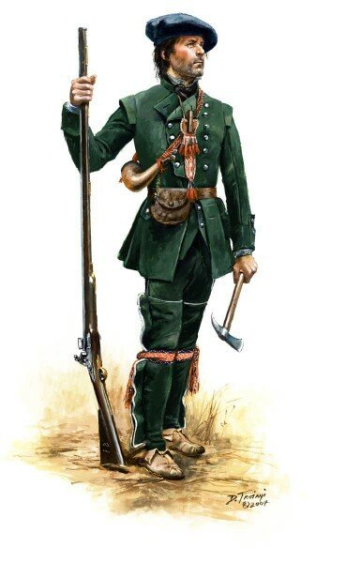
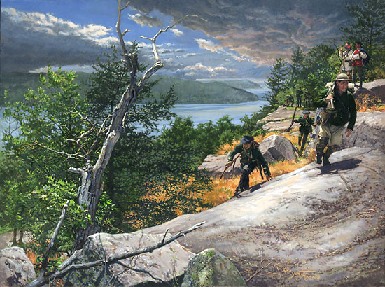
Roger’s Rangers
Started by New Hampshire’s Robert Rogers
Soldiers who moved quickly and fought Indian-style.
Looked down upon by the regular British army
The origins of today’s Army Rangers.
If you have the good fortune to take any prisoners, keep them separate, till they are examined, and in your return take a different route from that in which you went out, that you may the better discover any party in your rear, and have an opportunity, if their strength be superior to yours, to alter your course, or disperse, as circumstances may require.
If you march in a large body of three or four hundred, with a design to attack the enemy, divide your party into three columns, each headed by a proper officer, and let those columns march in single files, the columns to the right and left keeping at twenty yards distance or more from that of the center, if the ground will admit, and let proper guards be kept in the front and rear, and suitable flanking parties at a due distance as before directed, with orders to halt on all eminences, to take a view of the surrounding ground, to prevent your being ambuscaded, and to notify the approach or retreat of the enemy, that proper dispositions may be made for attacking, defending, And if the enemy approach in your front on level ground, form a front of your three columns or main body with the advanced guard, keeping out your flanking parties, as if you were marching under the command of trusty officers, to prevent the enemy from pressing hard on either of your wings, or surrounding you, which is the usual method of the savages, if their number will admit of it, and be careful likewise to support and strengthen your rear-guard.

Slide 12
Louisbourg
St-Francois
Ft. Frontenac
Ft. Ticonderoga
Ft. Duquesne

Slide 13
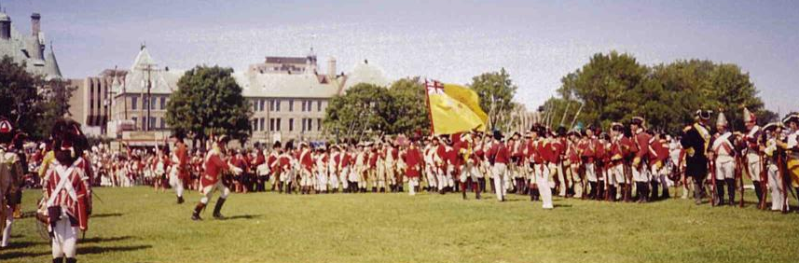
The Turning Point
The British capture forts throughout America – but Quebec City & Montreal remain the key to New France.
In 1759 British General James Wolfe led his troops to Quebec, and surrounded the city on the Plains of Abraham in a surprise attack.

Slide 14
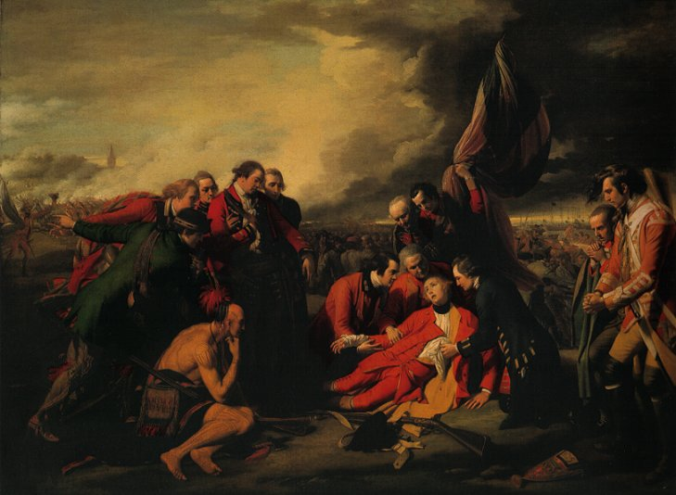

WOLFE WINS!
(but dies, as does the Marquis de Montcalm)
The French lose the Battle of Quebec, and a few months later Montreal. The war ends in 1763.

Slide 15

Treaty of Paris - 1763
England gets: Canada, all land east of the Mississippi River, and Florida (from Spain)
Spain gets: All land west of the Mississippi River, and New Orleans
France gets: Kicked out of North America

Slide 16
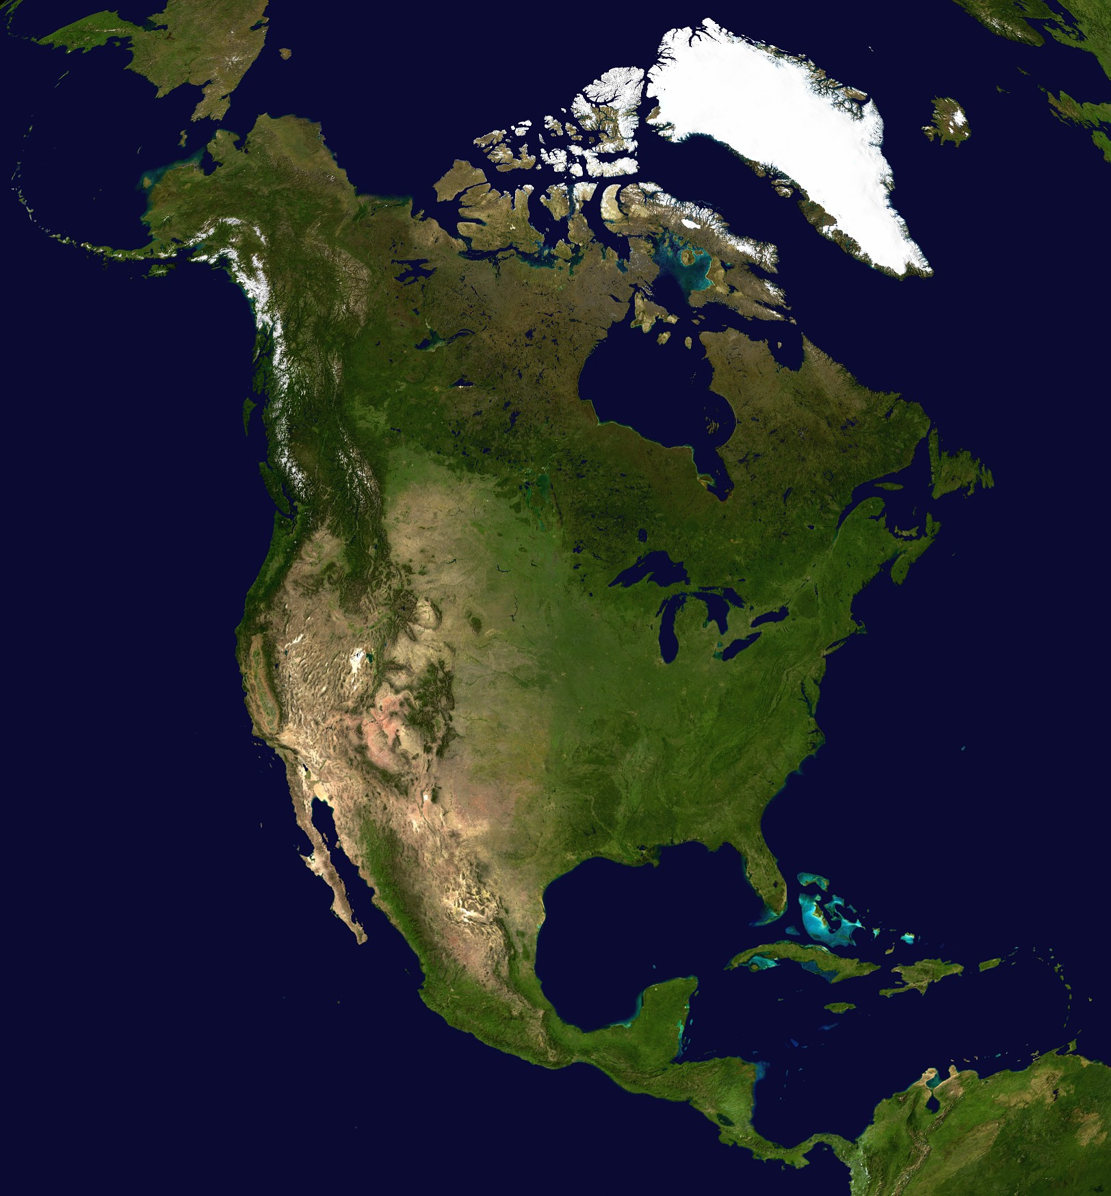
Rupert’s Land
NFL
Canada
“14 Colonies”
Louisiana
Florida
Mexico

Slide 17
Rupert’s Land
NFL
Quebec
Louisiana
“15 Colonies”
Mexico

Slide 18

British Empire, 1763

